Slide 1
National Rural Employment Guarantee Act (NREGA) Analysis
Smith-Mensah Kimbel
kimbelsmith111@gmail.com
(233)20 467 4920

Slide 2
Overview
This project delves into the analysis of data related to the National Employment Guarantee Act(NREGA), a transformative government scheme aimed at providing rural households with guaranteed wage employment opportunities.
Through the application of data analytics techniques, we aim to gain valuable insights into the implementation of NREGA across different states and districts in India.

Slide 3
Problem Statement
NREGA is a vital initiative to alleviate rural unemployment and poverty. This project seeks to address several key questions and challenges associated with NREGA:
● How effective is NREGA in providing employment opportunities to rural households?
● Are there regional disparities in the implementation and outcomes of the scheme?
● What is the utilization of the allocated budget, and how does it correlate with employment generation?
● What are the key factors contributing to the completion of NREGA works, and are there any roadblocks to its success?
● Can data-driven insights guide policymakers and administrators in optimizing the scheme's impact?

Slide 4
Dataset Information
The dataset used for this analysis is sourced from official government records and contains information related to NREGA implementation across various states and districts in India.
It comprises 28 columns, encompassing data on job cards, worker details, budget allocation, work completion statistics, expenditure, and more.
This dataset offers a comprehensive view of the progress and challenges faced by the NREGA program.

Slide 5
Project Scope
The project aims to analyze and visualize the NREGA dataset to extract meaningful insights.
The scope includes:
Data preprocessing and cleaning to ensure data quality.
Exploratory data analysis (EDA) identify patterns, trends and disparities in NREGA implementation.
Utilizing data visualization techniques to present key findings effectively.
Drawing actionable insights to inform policymakers and administrators about the strengths and weaknesses of the NREGA program.
Suggesting data-driven recommendations for optimizing the impact of NREGA in different regions.

Slide 6
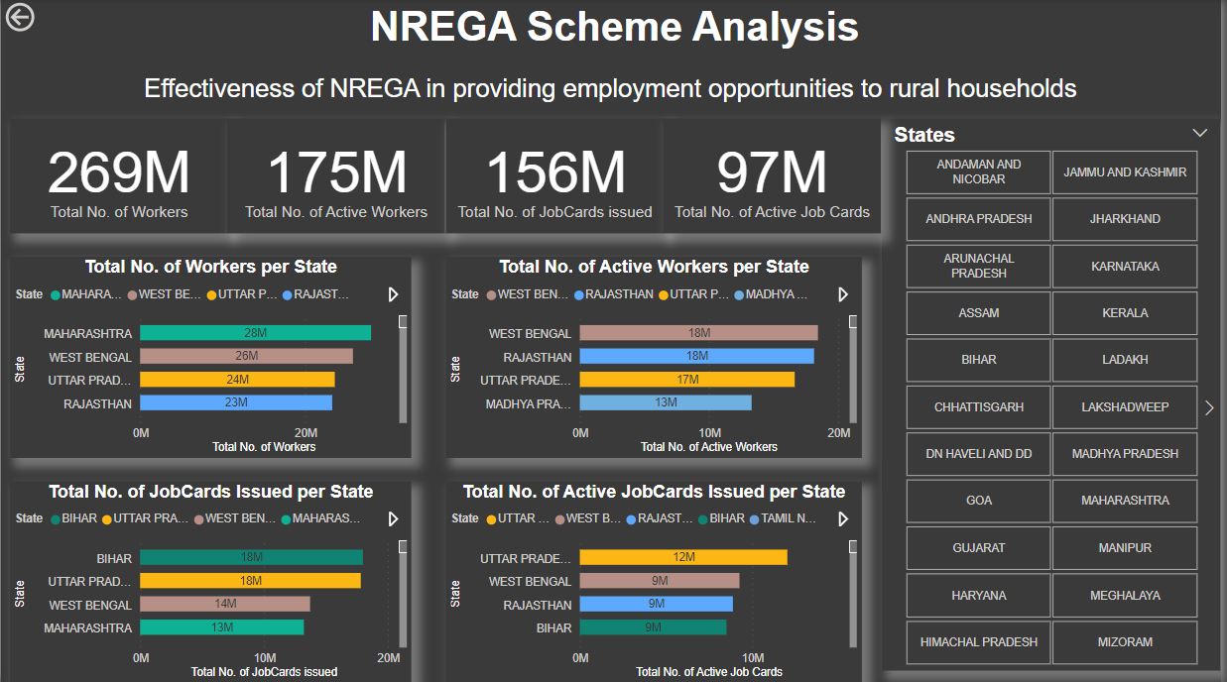
How effective is NREGA in providing employment opportunities to rural households

Slide 7
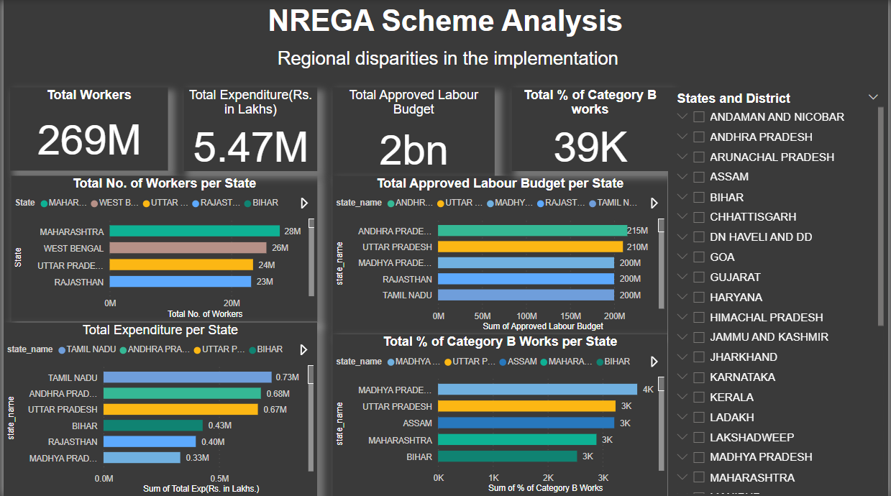
Regional disparities in the implementation

Slide 8
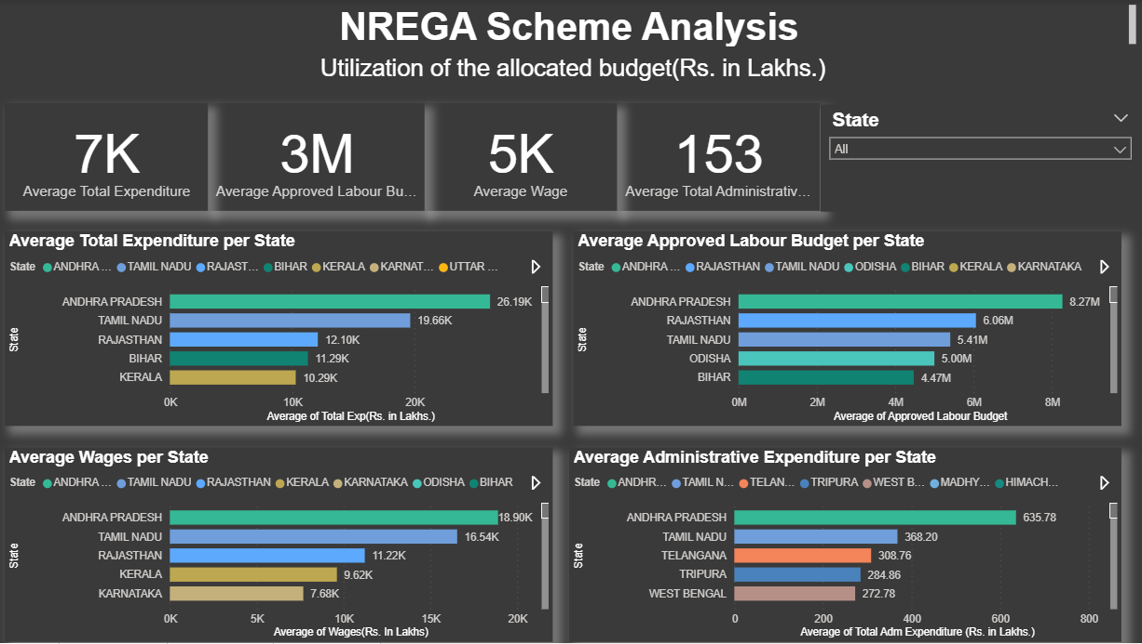
Budget Utilization

Slide 9
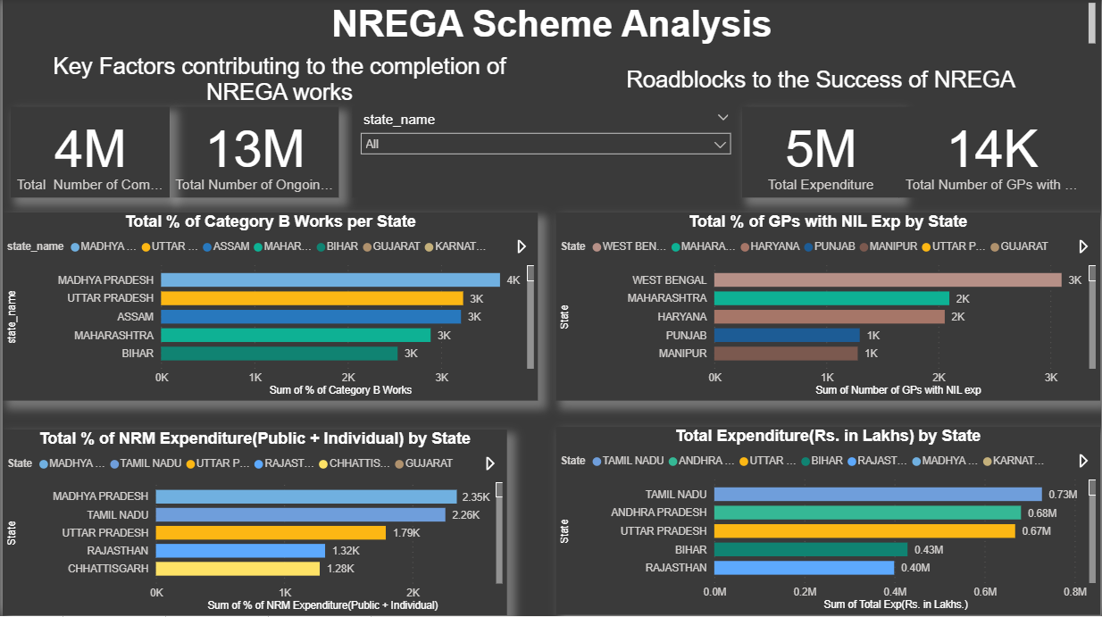
What are the key factors contributing to the completion of NREGA works and roadblocks to its success

Slide 10
Driven Insights
NREGA has issued a significant number of job cards and provided employment to a large number of workers.
The mean number of active workers and job cards suggests that a substantial proportion of issued job cards are actively providing employment.
Higher budget allocations are positively correlated with increased employment opportunities and higher expenditure.

Slide 11
Recommendations
Increase Budget Allocation: Regions with lower employment generation and work completion should receive increased budget allocations to enhance their NREGA performance.
Focus on Work Completion: Enhance monitoring and support for ongoing projects to ensure higher completion rates.

Slide 12
Thank You

